Slide 1


Booth’s Algorithm Session No.: 22 Course Name: Computer Organization and Architecture Course Code: R1UC305T Instructor Name: Ms. Trapti Shrivastava Duration: 50 Min. Date of Conduction of Class:

Slide 2
Learning Outcome
Explain the motivation, working principle, and operational rules of Booth’s Algorithm for signed binary multiplication.

Slide 3
Session Outline
1. Introduction
2. Motivation for Booth’s Algorithm
3. Classroom Activity – Think–Pair–Share
4. Concept and Working of Booth’s Algorithm
5. Advantages and Summary

Slide 4
Recap

Slide 5
Open-ended Question
When computers multiply two signed binary numbers, what challenges do you think arise compared to multiplying two positive numbers and how might an algorithm overcome them?

Slide 6
Motivation for Booth’s Algorithm
Booth’s algorithm multiplies binary integers in signed 2’s complement representation.
Key idea:
Strings of 0s → only shifting, no addition needed.
Strings of 1s (from bit weight 2^k to 2^m) can be expressed as 2^(k+1) – 2^m.
Example: 001110 (decimal +14)
String of 1’s from 2³ to 2¹
Represented as: 2^(3+1) – 2^1 = 16 – 2 = 14
Multiplication M × 14 becomes:
M × 2⁴ – M × 2¹

Slide 7
Classroom Activity: Think–Pair–Share
Multipliers:
001110
111100
000111
Task: Spot patterns of 1’s and 0’s.
Which multipliers are costly in naive multiplication? How could patterns help reduce steps?

Slide 8
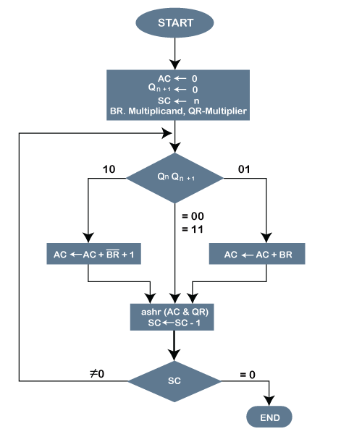
Concept of Booth’s Algorithm
The multiplicand is subtracted from the partial product upon encountering the first least significant 1 in a string of 1's in the multiplier.
The multiplicand is added to the partial product upon encountering the first 0 (provided that there was a previous 1) in a string of 0's in the multiplier.
The partial product does not change when the multiplier bit is identical to the previous multiplier bit.

Slide 9
Rules of Booth’s Algorithm
Condition | Action
Encounter first 1 in a string of 1’s (10) | Subtract multiplicand
Encounter first 0 after a 1 (01) | Add multiplicand
Multiplier bit = previous bit (00 or 11) | No change

Slide 10
Advantages of Booth’s Algorithm
Handles signed numbers in 2’s complement directly.
Eliminates unnecessary additions for long runs of 1’s or 0’s.
Efficiency gained by replacing runs of 1’s with fewer operations.
Overflow avoided

Slide 11
Summary & Next Lecture
Booth’s Algorithm = efficient signed multiplication method.
Key tricks:
Strings of 0’s → just shifts.
Strings of 1’s → represented as 2^(k+1) – 2^m.
Uses add/subtract rules with bit pairs.
Next Lecture: Hardware setup, detailed flowchart, negative multipliers.

Slide 12

Review and Reflection from students

Slide 13
Thanks

